Slide 1
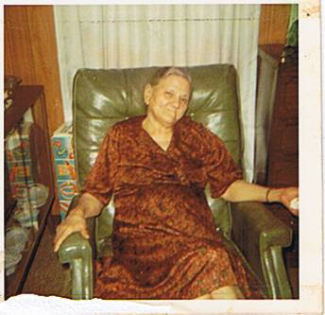
Mabel Dove ( Christmas 1970)

Slide 2
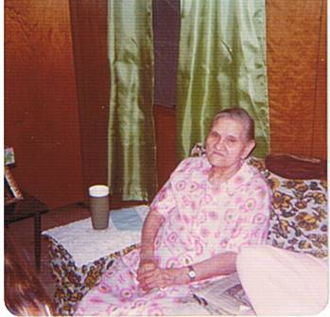
Mabel Dove 1975

Slide 3
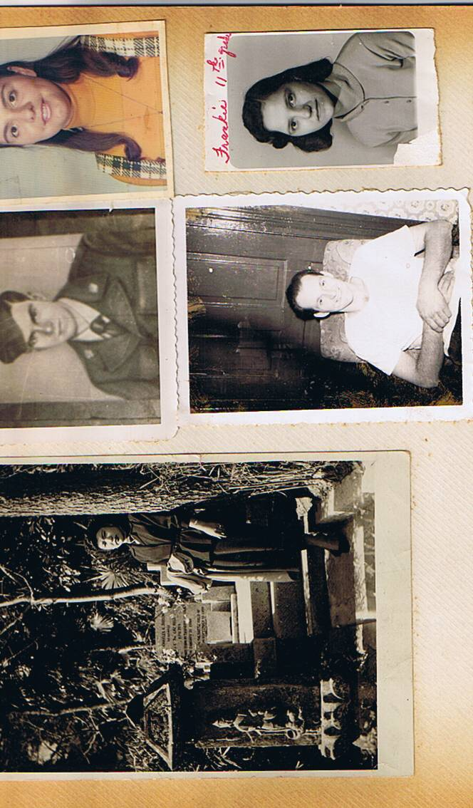

Slide 4
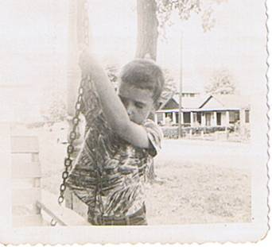
Buddy Seven Years Old

Slide 5
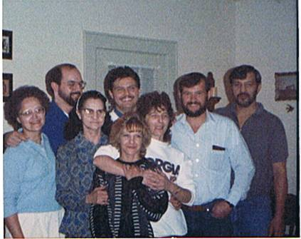
Maynard ‘s

Slide 6
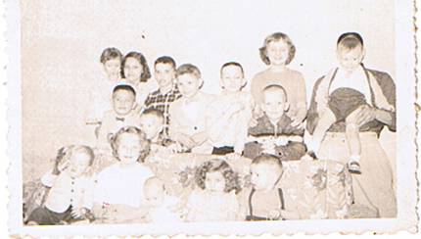
Mabel Dove’s Grandchildren

Slide 7
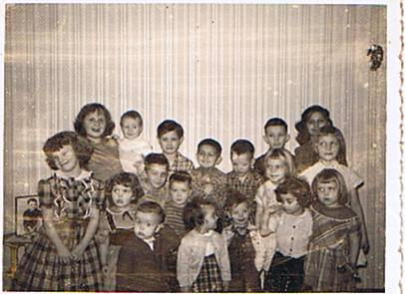
Mamaw Dove’s Grandchildren

Slide 8
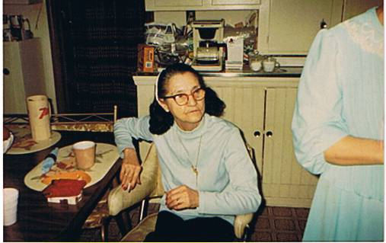
Elizabeth - 1988

Slide 9
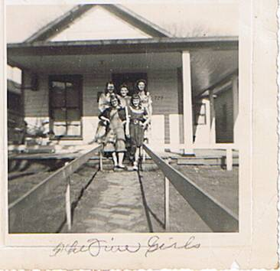
Lucille, Harriett, Elizabeth, Betty & Dottie ( 2-6-1949 )

Slide 10
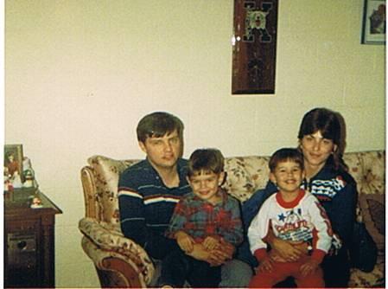

Slide 11
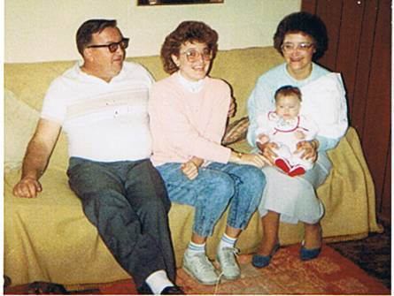
Junior, Missy, Frankie and Sarah Louise Dove 1987

Slide 12
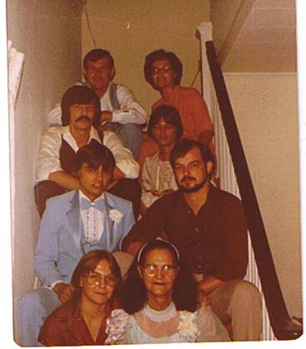
Arnold, Frankie, John, Bobbie, Mark, Jerry, Libby and Elizabeth ( Aug 9, 1980)

Slide 13
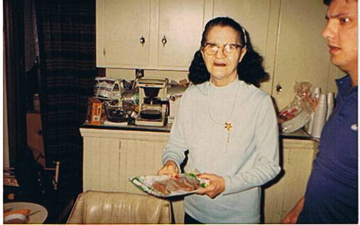
Elizabeth & Mark Maynard (April 1988)

Slide 14
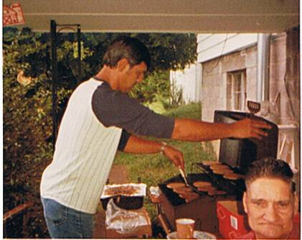
John Allen, Tossie Dove 1987

Slide 15
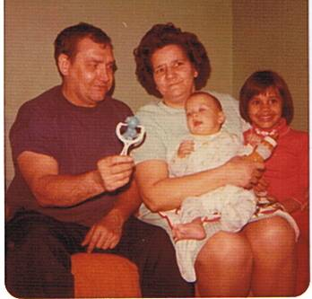
Edmond, Lucille, John Jr & Cherri Ann ( Oct 1976 )

Slide 16
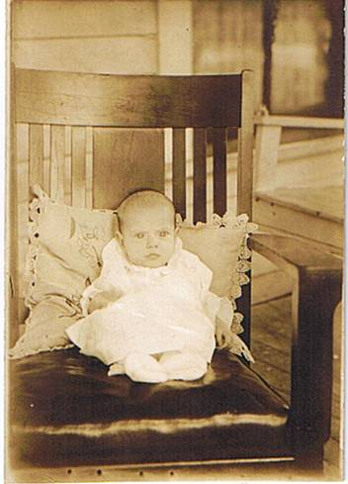
Harriett Louise Dove ( 6 months old ) 3/29/32

Slide 17
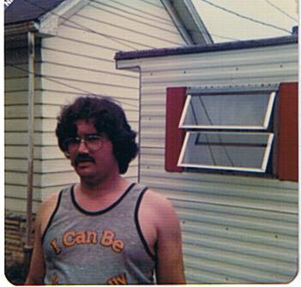
Buddy Staggs

Slide 18
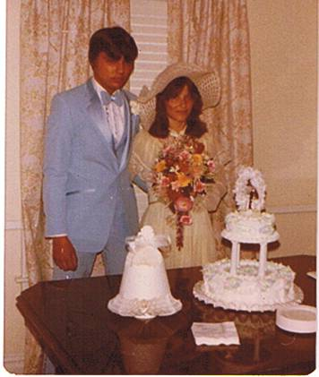
Mark & Joann ( Aug. 9, 1980 )

Slide 19
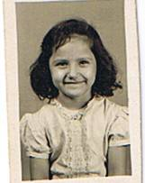
Frankie

Slide 20
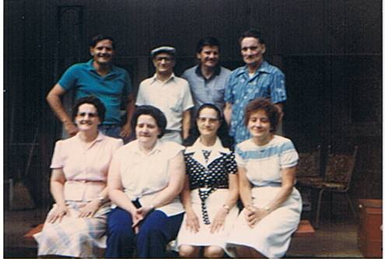
Charles, John, Carl, Allen Harriett, Lucille, Elizabeth, Dorthy July 1984

Slide 21
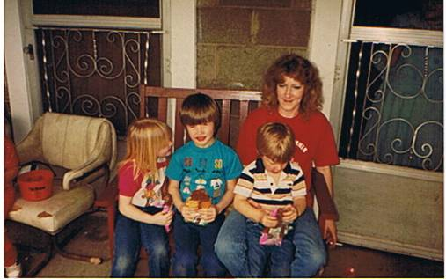
Brenda Walker ( Tessa, Jeremy & Joey )

Slide 22
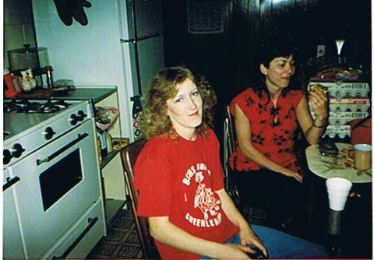
Brenda Walker & Joann Maynard

Slide 23
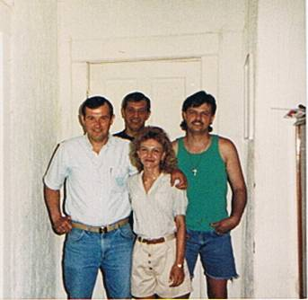
May 1993

Slide 24
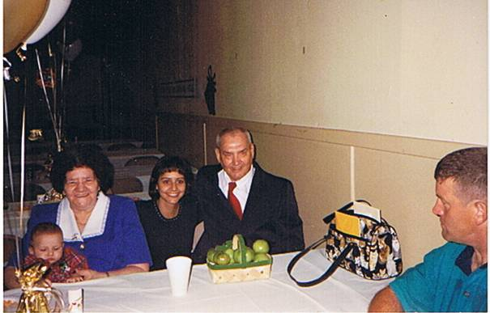

Slide 25
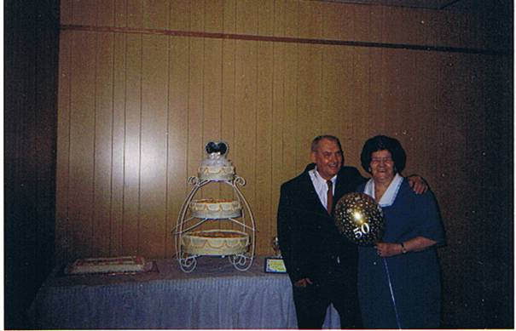

Slide 26
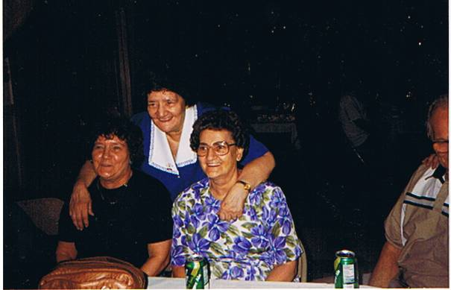

Slide 27
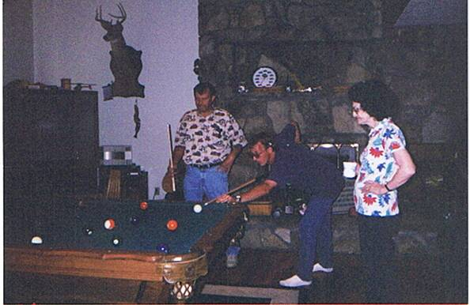

Slide 29
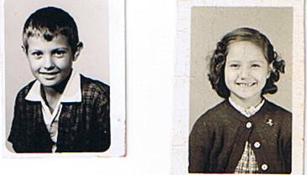
Arnold Jr (7th grade 1960-61) & Frankie

Slide 30
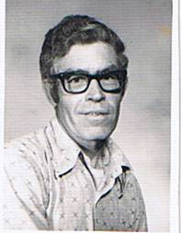
Ray Keeton

